Slide 1
Connections Through Peer Coaching: A Model For Supporting Student Success
Alexandra Castillo, Reginald Simmons, Ana Urquijo Aldana, Lilibeth Soto, & Natania Zureiqi
Central Connecticut State University

Slide 2
History of Success Central
Why train peer mentors in coaching techniques?
The four-year graduation rate of 2014-15 mentees was higher than the university average.
Mentees reported increased perception of their academic skills, confidence, and likelihood of graduating from college
In 2017-18, increased funding made SC available to all freshmen and sophomores, prioritizing first-generation students

Slide 3
Who Are The Mentors?
Junior and seniors of diverse racial, ethnic, major, and geographic backgrounds
Chosen mentors have at least a 3.0 grade point average, enthusiasm and many have backgrounds/experiences similar to the mentees
(first in family to attend college, jobs or other obligations that conflicted with academics, financial challenges, time-management, study skills, wavering confidence in academic ability, etc...)
Mentors are matched to mentees based on some common characteristic

Slide 4
Four Phases of CCSU Success Coaching
Phase One: Building a Connection
Phase Two: Collaboration
Phase Three: Reflection
Phase Four: Action
Review outcomes of action steps during the next session

Slide 5
How Program Operates
Mentors and mentees meet at least bi-weekly
Phone and text conversations as needed
30 minute sessions, varies to meet mentee’s needs
Flexibility
Utilize 4 phases during sessions

Slide 6
How Program Operates
Up to 12 students assigned to each mentor
Session notes
Weekly supervision

Slide 7
Benefits to the Mentee: Academic Support
Utilizing academic resources other students have found useful based on experience
Tips and tricks that may have worked for mentors include:
Providing info about on campus tutors & office hours
Organizational Strategies
Efficient Note-taking
Prepping for Exams

Slide 8
Benefits to the Mentee: Academic Support
Case Example: Mentee A
Mentee A felt overwhelmed with transitioning to college.
He identified that he wanted to start off college with good grades by addressing his procrastination.
Testing various academic resources until we found what worked for him.
i.e.: timesheet diary & planner
We worked together to map out when he could study and learned time management skills.
The student was able achieve his goal of A’s and (a couple of) B’s.

Slide 9
Benefits to the Mentee: Managing off-campus Stressors
Balancing family, school, and other potential stressful aspects of college students’ lives.
Case Example: Mentee B
Mentee B was able to manage her grades quite well.
She chose to focus on minimizing her level of family- related stress, in order to prioritize her education.
As a fellow Female Muslim Student, I was able to relate and comfort her because of my own experiences
We identified different ways to balance family- related stress as a college student.

Slide 10
Benefits to the Mentee: Campus Involvement
Focusing on the importance of the student’s connection to their campus.
How?
Promoting Club Fairs & Encouraging Campus Events
Recommending specific clubs/events based on the mentees’ interests
Discussing mentors’ personal experiences with on-campus opportunities
i.e. Internships, work-studies, community work, etc.

Slide 11
Benefits to the Mentee: Campus Involvement
Case Example: Mentee C
Mentee C is an outstanding student academically and joined the program in hopes to feel more a part of her college community.
Because we were both psychology majors, I recommended an on-campus event, “Self-Check-in”, that emphasizes the importance of mental health
She formed many friendships, including her new roommate after visiting campus events, like Self-Check-in.
Mentee C is currently in the running to become a mentor this upcoming semester.
Has the potential to experience the beneficial aspects of Success Central Initiative from a different perspective.

Slide 12
Benefits to Mentor
Becoming a Role Model
My mentees understood that I was going through “the struggle” with them
They saw that I finished my four years and went on to graduate
I want them to always see that hard work pays off so I make it pay off
Accountability
Mentees and I have a mutual respect and communicate openly
When they set goals I expect them to follow through. I hold myself to the same expectations
New Found Passion
Through this experience as a mentor I discovered that I love doing this kind of work
I love helping young people and plan to continue

Slide 13
Benefits to Mentor
Practice What You Preach
I tell my mentees things I truly believe and try to practice in my own life
Self Care
Delayed Gratification
Consistency
Moments in my life that I find myself forgetting, I remember how much emphasis I put into those small lessons and I re adjust and move forward

Slide 14
Benefits to Mentor
Rewarding Experience
Mentees show their appreciation differently. Whether it’s a grand thank you or not I know that they left our last meeting knowing that I am their mentor even after the year.
Knowing I helped students set goals and reach them
Best job I’ve had in or out of school
I want to continue working with young people

Slide 15
Case Highlight
A mentee and I connected over similar life experiences.
She is currently living with friends and technically homeless. During a brief time in my life I was also displaced and could relate to those emotions.
Helping her move forward, helped me come into better terms with things in my past.
We met weekly for an hour to discuss challenges she faced and help guide her through solutions.
She attended my graduation ceremony and said that being there and watching me walk made her excited for her time.

Slide 16
Mentor Testimony

Slide 17
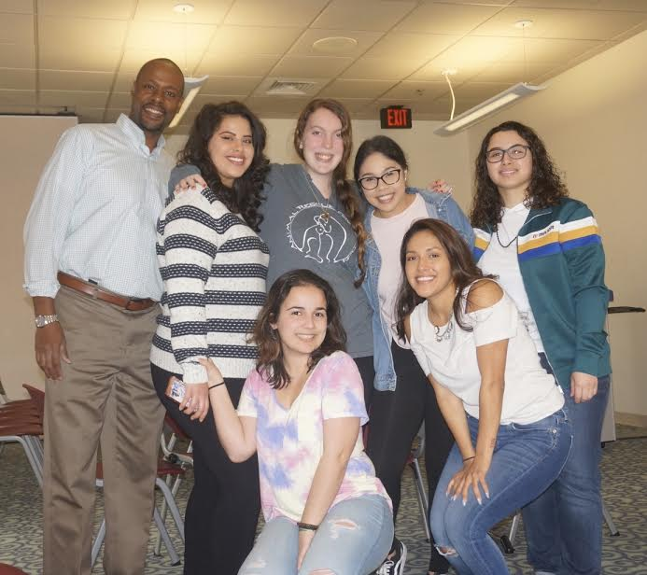
Meet our Team!

Slide 18
Audience Q&A

Slide 19
Thank You! For questions, feel free to email Alexandra Castillo at acastillo81211@gmail.com or Reginald Simmons at simmonsred@ccsu.edu

